Slide 1
UNIT-I: Basics of Control System
Unit A - Topic I
Basic Elements of Control System
Open and Closed Loop Systems
Unit A – Topic II
Potentiometers
Synchros
AC and DC servomotors
Stepper motor
Ac tacho- generator
Gyros.

Slide 2
Contd…………
Unit A – Topic III
Transfer function
Block diagram reduction technique
Signal flow graph
Electrical analogy of mechanical system

Slide 3

Block Diagram Reduction Technique
Block Diagram??????
Block Diagram is a pictorial representation of the cause and effect relationship between input and output of the system.
Block Diagram of Physical
System
Input
Output
Or
R(s)
G(s)
C(s)
i.e., C(s) = G(s) R(s)

Slide 4
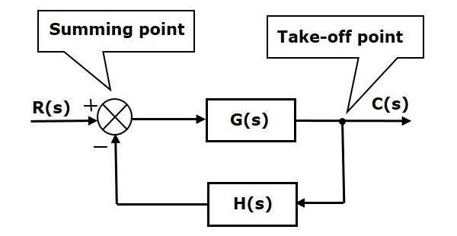
Summing Point and Take-off Point
Summing Point: More than one signal can be added or subtracted at summing point.
Take-off Point: The point from which a signal is taken for the feedback purpose
is called as take-off point.

Slide 5
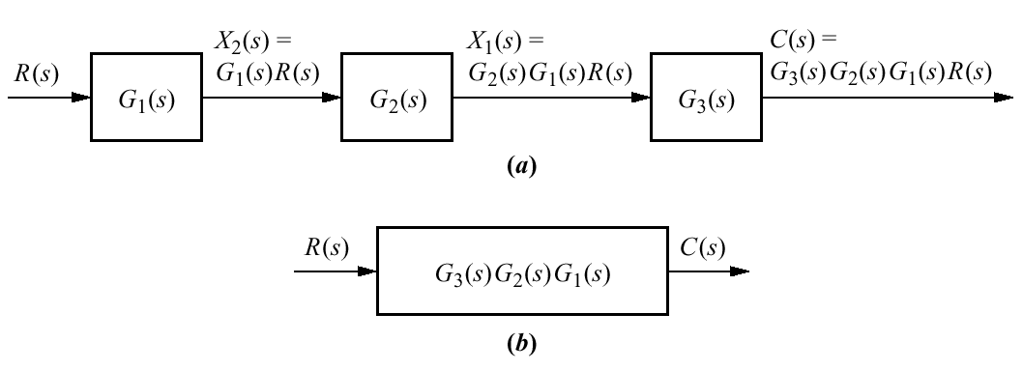
Rules for Block Diagram Reduction
Rule 1: Blocks in Cascade/Series:

Slide 6
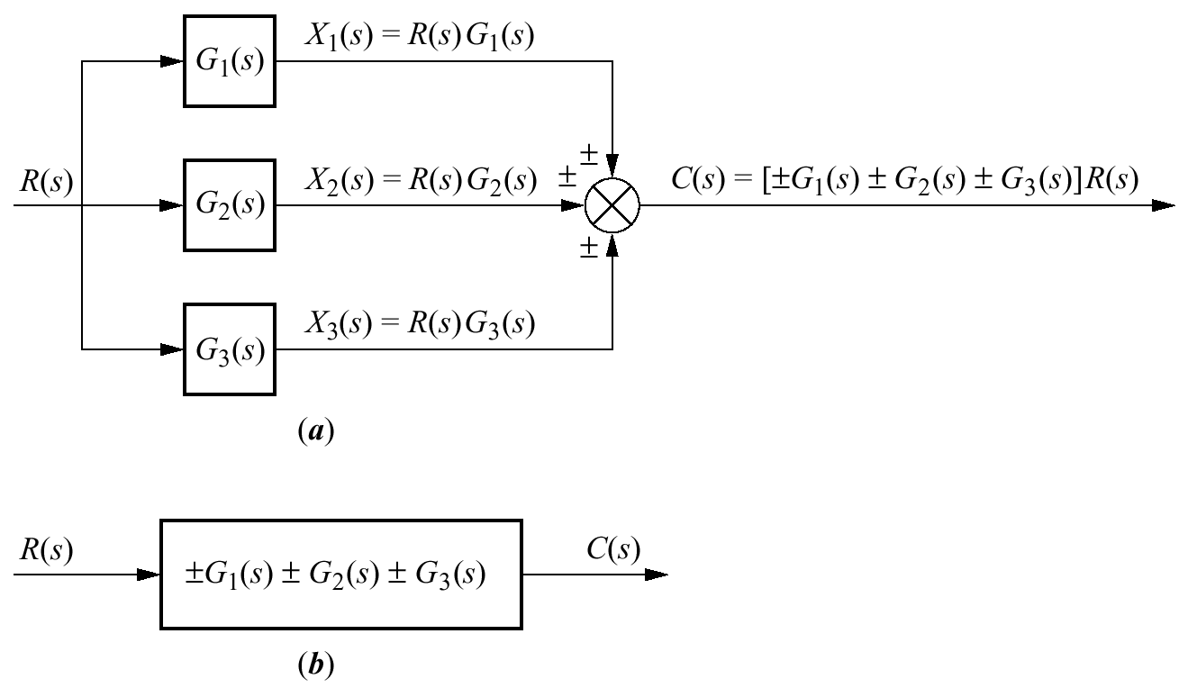
Rule 2: Blocks in Parallel:

Slide 7
Rule 3: Associative Law for summing point:
i.e., the order of a summing point can be changed if two or more summing points are in series ( output remains same)

Slide 8
Rule 4: Shifting a summing point from a position before a block to a
position after the block
i.e., to shift a summing point after a block, add a block having same transfer
function at the summing point.

Slide 9
Rule 5: Shifting a summing point from a position after a block to a
position before the block
i.e., to shift a summing point before a block, add a block with inverse
of same transfer function at the summing point.

Slide 10
Rule 6: Shifting a take-off point from a position before a block to a
position after the block
i.e., to shift a take-off point after a block, add a block with inverse
of same transfer function in series with take-off signal.

Slide 11
Rule 7: Shifting a take-off point from a position after a block to a
position before the block
i.e., to shift a take-off point before a block, add a block with
same transfer function in series with take-off signal.

Slide 12
Rule 8: Shifting a take-off point from a position before a summing point
to a position after the summing point

Slide 13
Rule 9: Shifting a take-off point from a position after a summing point
to a position before the summing point

Slide 14
Rule 10: Elimination of a summing point from a closed loop system

Slide 15
Example -1: Reduce the Block Diagram to obtain C/R
_
+
+
_
+
+

Slide 16
_
+
+
+
_
+

Slide 17
_
+
+
+
_
+

Slide 18
_
+
_
+
+
+

Slide 19
_
+
_
+

Slide 20
_
+
_
+

Slide 21
+
_

Slide 23
Thank You

